Slide 1
LECTURE 1

Slide 2
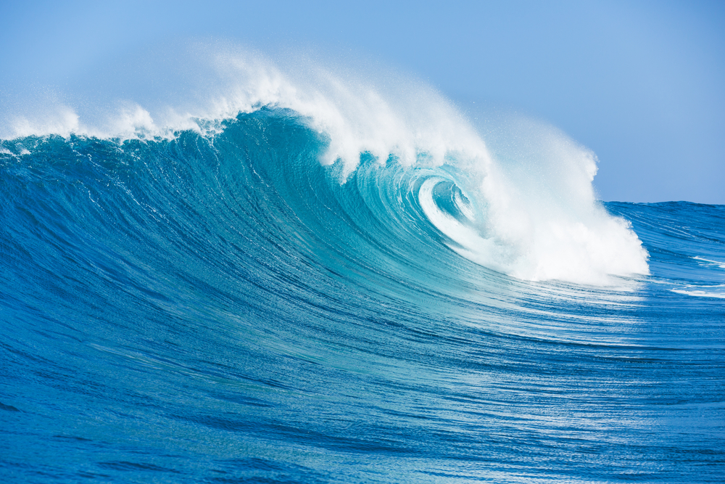
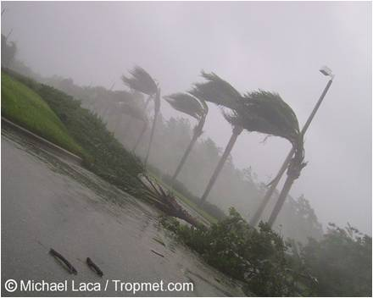

Current
ELECTRIC CURRENT
means
Electric current
is the flow of electrons in a conductor
Electric current is the amount of charge flowing
through a particular cross section area in unit time
Or
Flow
cross section area
Amount of charge
Electric Current
=
Conductor
cross
sectional
area
Unit time
When water flows from one place to another it is called
When wind flows from one place to another it is called
WATER CURRENT
WIND CURRENT

Slide 3
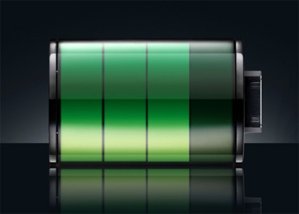
What makes the charge flow?
CELL
+
-
+
–
Tank A
Positive
terminal
Negative
terminal
terminal
terminal
Tank A
Tank B
Higher electric potential
Lower electric potential
potential
potential
40° C
40° C
60° C
60° C
20° C
20° C
Difference between higher potential and lower potential
Potential Difference
A
A
B
B
The function of the cell is to create potential difference
Higher Temperature
Lower Temperature

Slide 4
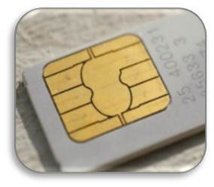
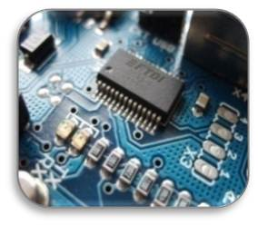
Now what is a free electron ?
In non -metals the number of electrons in outermost orbit is more
In metals the number of electrons in outermost orbit is less
Hence, electrons are lightly bound
Hence, electrons are strongly bound
i.e. 1,2,3 electrons
i.e. 5,6,7 electrons
Depending on the number of free electrons, substances are classified into :z
Between the nucleus and electron there is a force of attraction called
Electrostatic Force
of Attraction
n
CONDUCTORS
Have large number of free electrons, which are charge carriers.
p+
INSULATORS
Nucleus
Have less or practically no free electrons
Sim card is made up of semi conductor
SEMICONDUCTORS
IC (Integrated Circuit)
They do not have free electrons at room temperature, but can develop under specific condition
FREE ELECTRON

Slide 5
A substance which does not allow charges to pass through it, easily is called as ..................... .
Insulators do not have free electrons
(a) metal (b) conductor
(c) insulator (d) semiconductor
(c) insulator
As they have concentration of negative charge
Negative terminal is called .............. .
(a) higher electric potential (b) lower electric potential
(c) pole (d) None of these
(b) lower electric potential
Free electrons are generated on imparting heat
Substances which do not have free electrons, but can develop under specific condition are called .....
(a) metals (b) non - metals
(c) semi conductors (d) super conductors
(c) semi conductors
Cell creates potential difference
The function of the cell is ____________
(a) To create difference (b) to create drop
(c) To create potential difference (d) to develop free electrons
(c) To create potential difference

Slide 6
Flow of current in a Wire
Atoms in the state of vibration
Free electrons in the state of random motion
Electrons move with a certain average drift
drift
As net displacement is zero,
net current is also zero
5
5
4
Average Velocity
6
+
-
Conventional Current
(from +ve to -ve)
Flow of free electrons
(from –ve to +ve)
6
4

Slide 7
POTENTIAL DIFFERENCE
As charge is flowing, work is done
High potential
Due to difference in potential, charge will flow from higher to lower
Low potential
_
+
Metal Wire
A
B
Insulated stand
Insulated stand
Potential Difference
The electric potential difference between two points in an electric Circuit is defined as the amount of the work done in moving a unit positive charge from one point to another point.

Slide 8
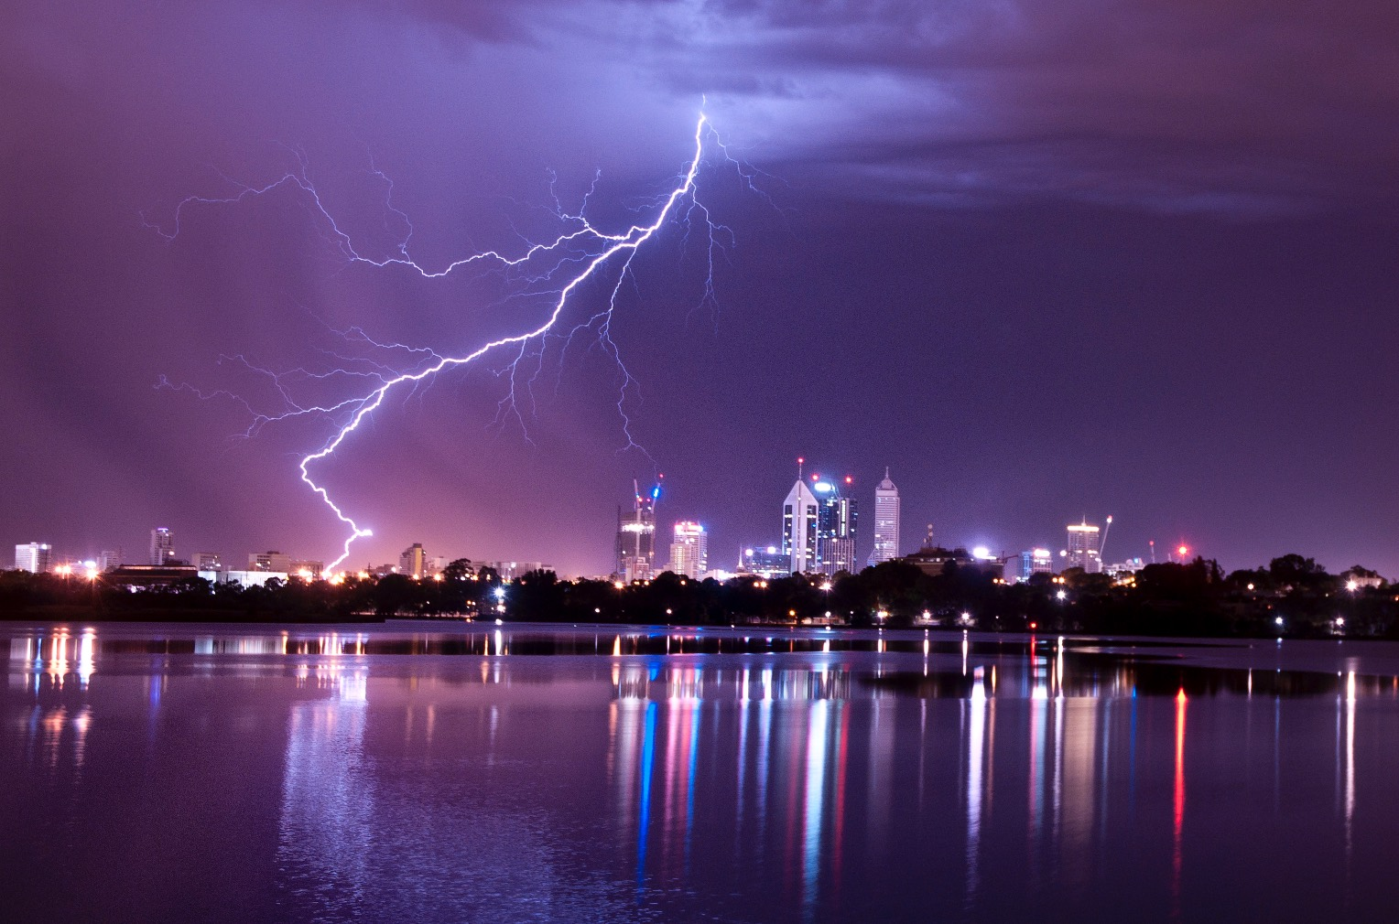


How does lightning occur
+
+
+
+
+
+
+
+
+
+
+
+
+
+
+
+
+
Static Charges
∴ clouds are at high potential
Earth is at zero potential
Charges travel from high potential to low potential

Slide 9
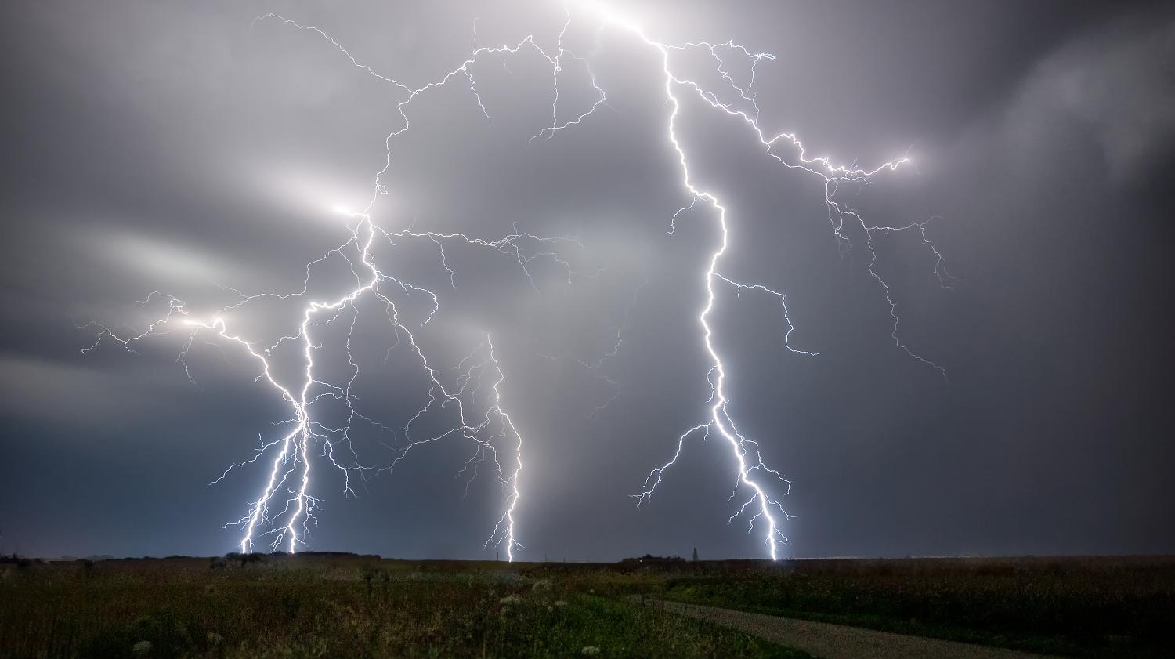

Slide 10
The electrons flow from negative terminal to positive terminal of the cell but the ............ of current is from positive terminal to negative terminal of the cell.
Conventional direction of current
is opposite to the direction of flow of electrons
(a) conventional direction (b) electron current
(c) real current (d) negative
(a) conventional direction
As cell contains higher potential and lower potential
The function of the cell is to create .................
potential difference (b) develop charges
random motion of electrons (d) none of these
(a) potential difference
As earth is a infinite body
The potential of earth is .......
(a) positive potential (b) zero potential
high potential (d) changes as per condition
(b) zero potential

Slide 11
Thank You

